Slide 1
What Is a Computer?
UEP A

Slide 2
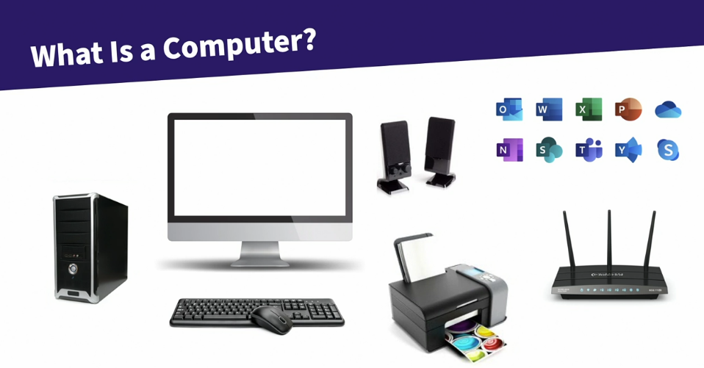

Slide 3
What is inside of a computer?

Slide 4
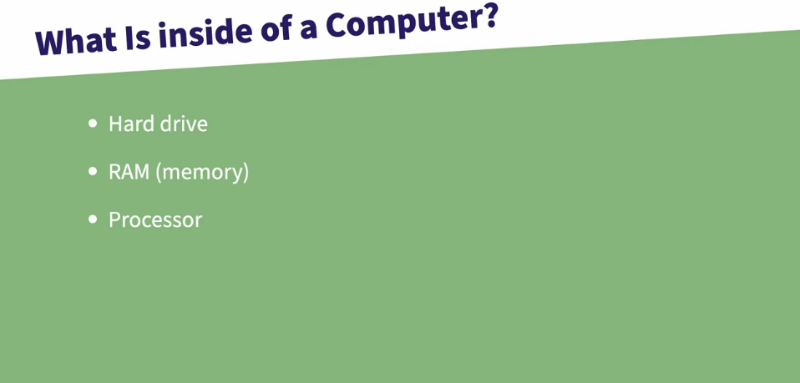

Slide 5
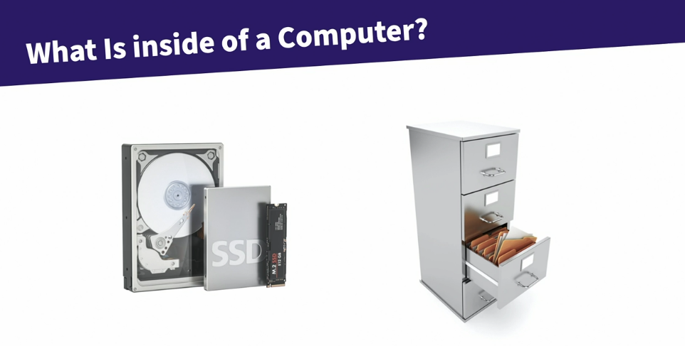

Slide 6
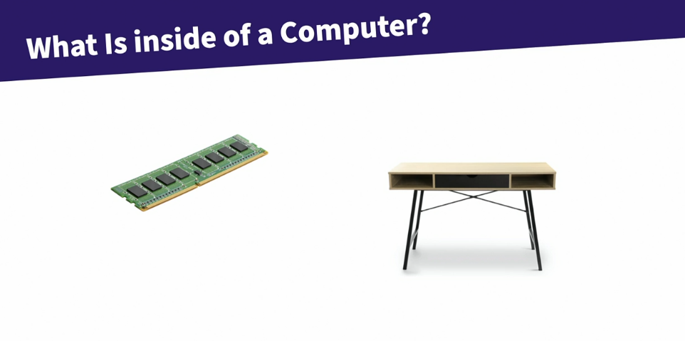

Slide 7
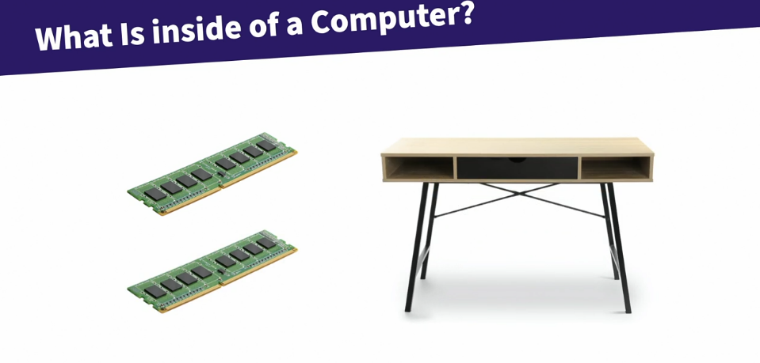

Slide 8
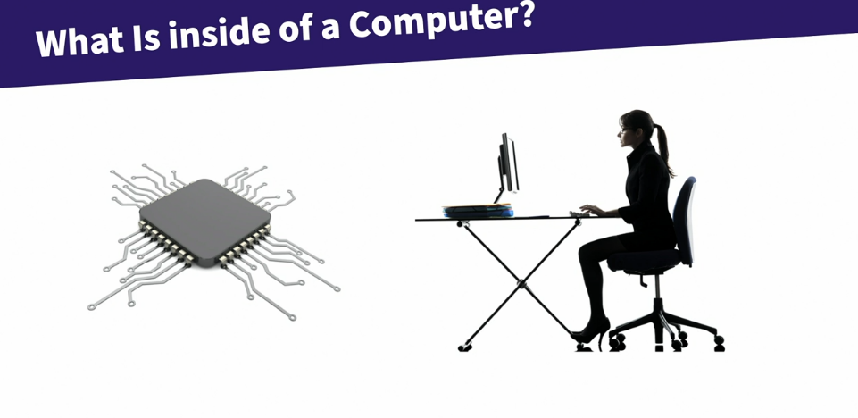

Slide 9
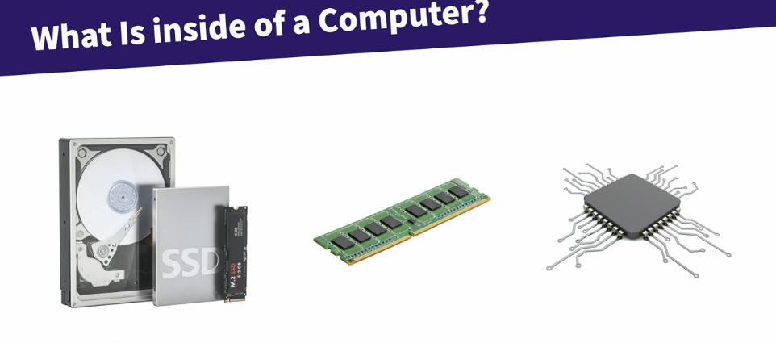

Slide 10
Desktop, Laptop, Tablet

Slide 11
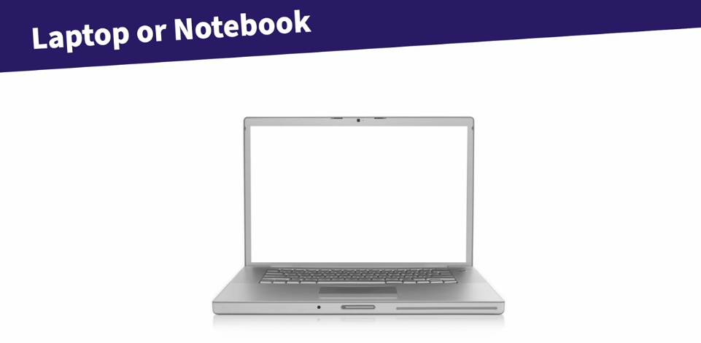

Slide 12
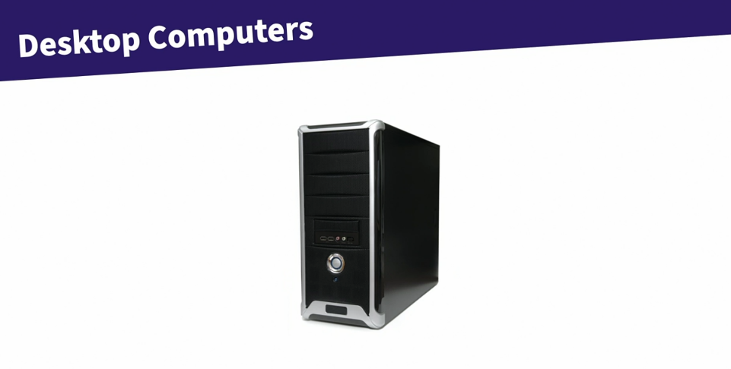

Slide 13
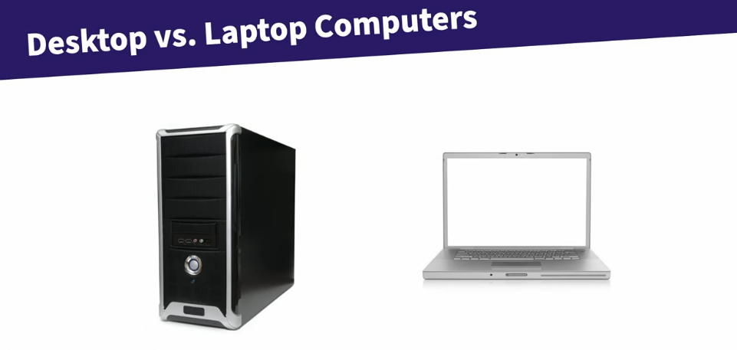

Slide 14
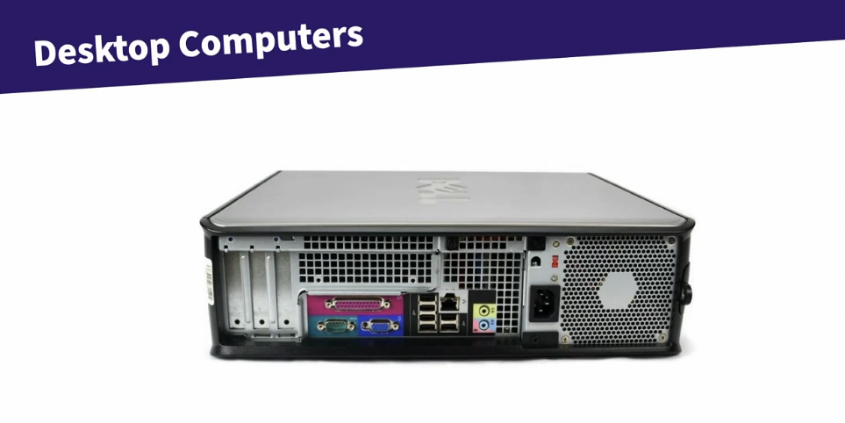

Slide 15
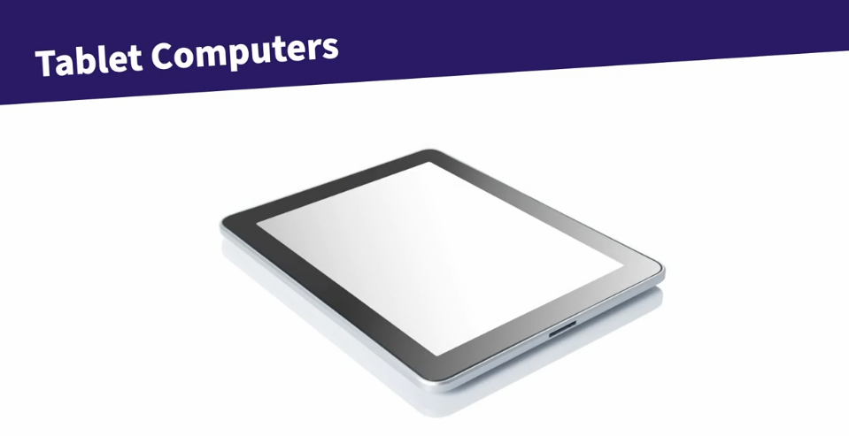

Slide 16
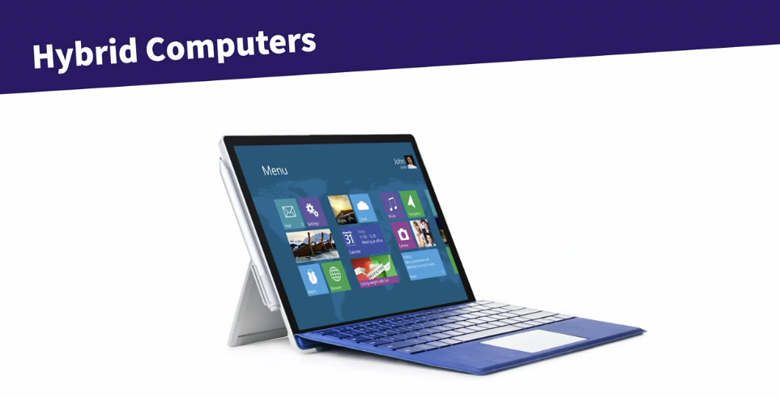

Slide 17
Laptop Considerations

Slide 18
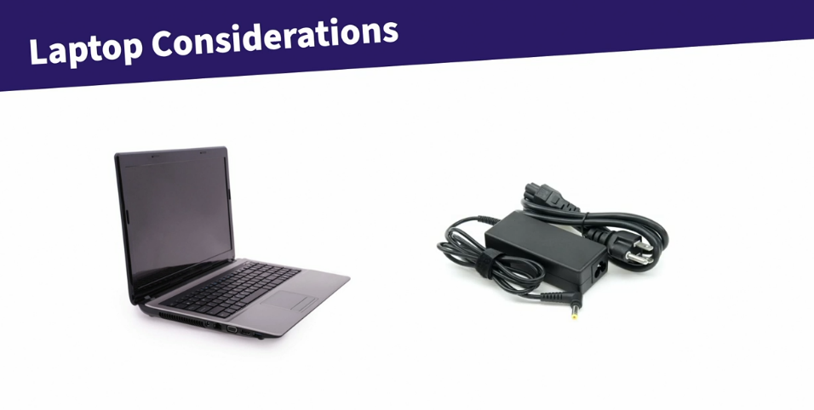

Slide 19
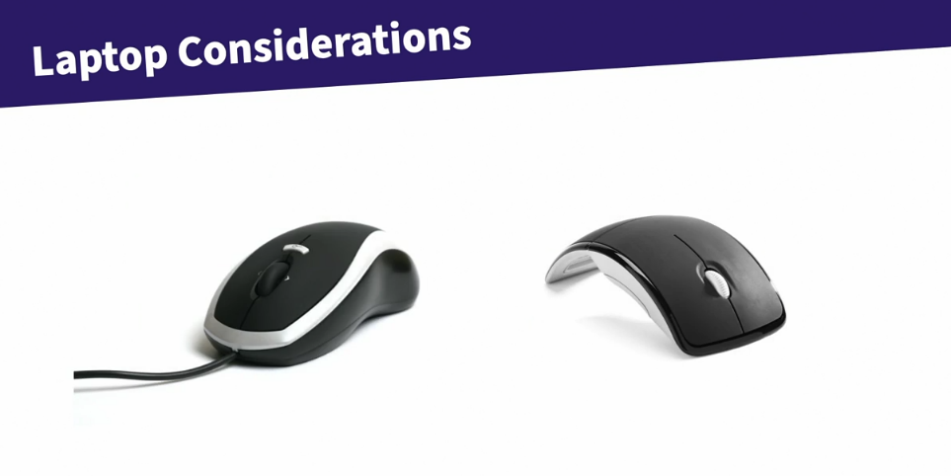

Slide 20
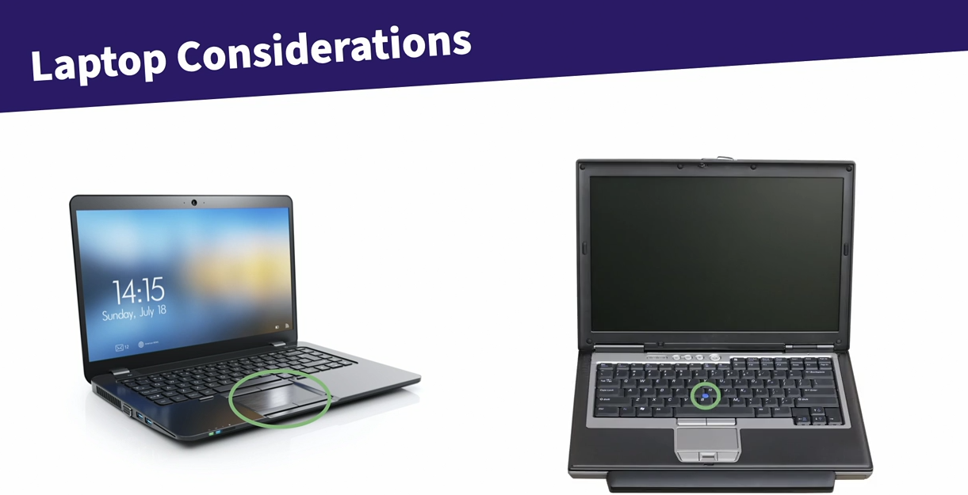

Slide 21
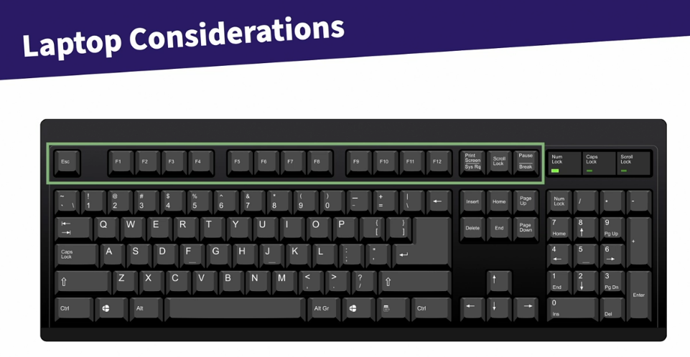

Slide 22
Understanding the Operating System (OS)

Slide 23
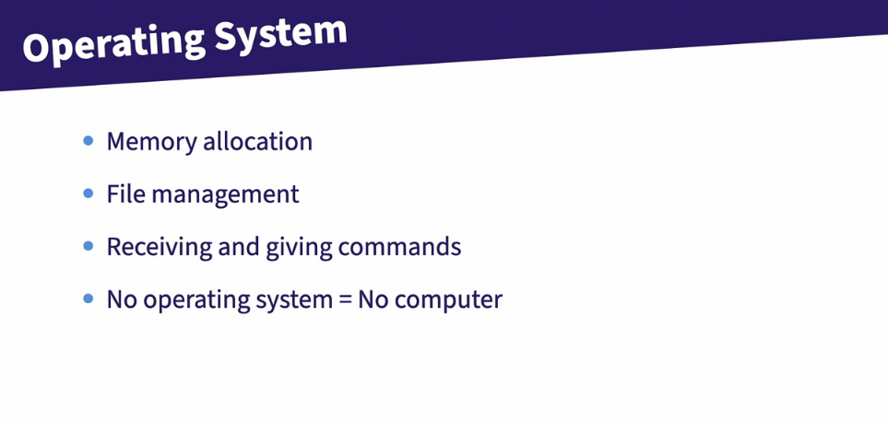

Slide 24
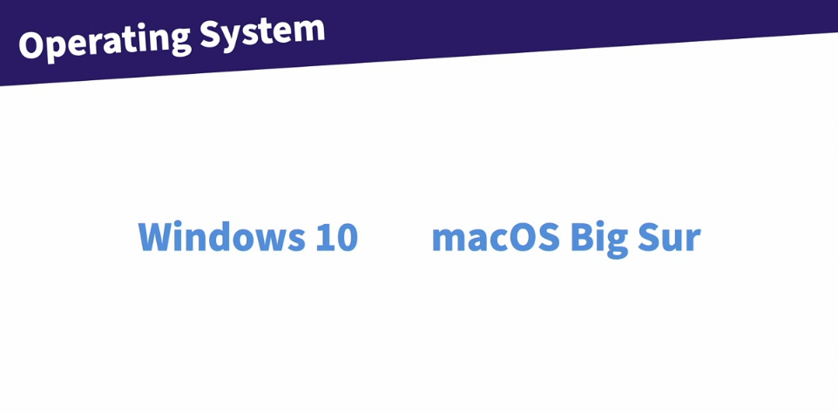


Slide 25


Slide 26
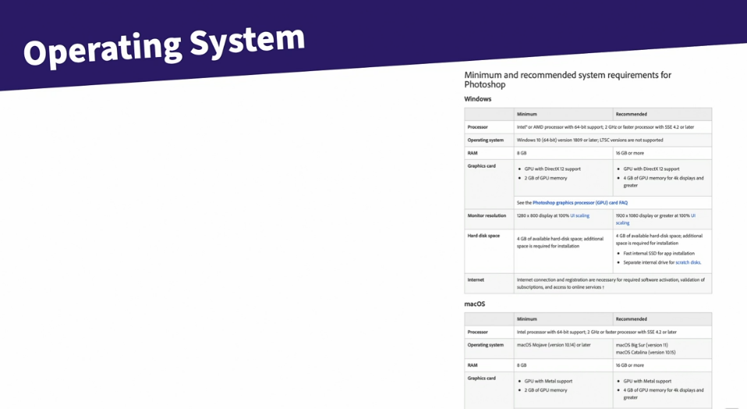

Slide 27
Understanding Files and Folders

Slide 28
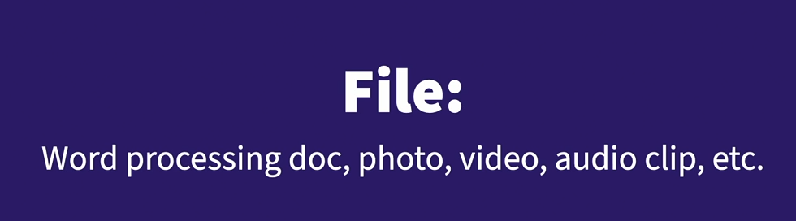

Slide 29


Slide 30
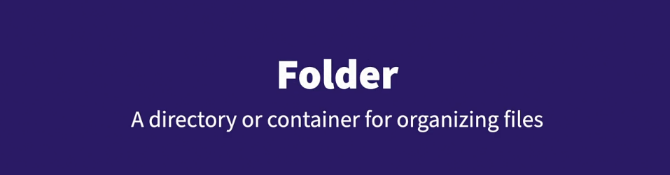

Slide 31
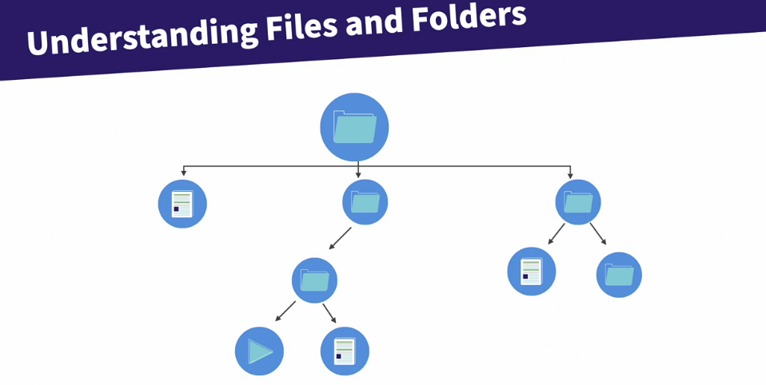

Slide 32
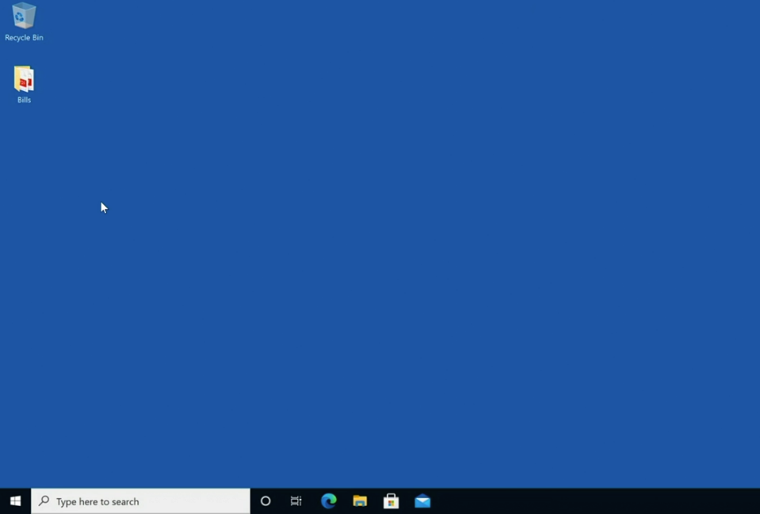

Slide 33
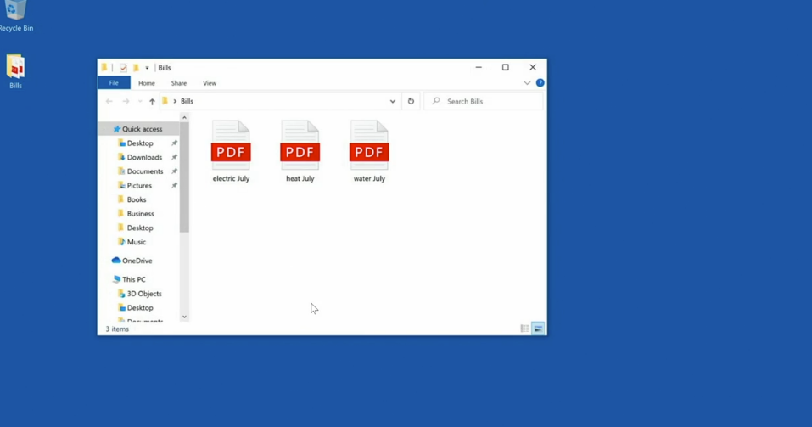

Slide 34
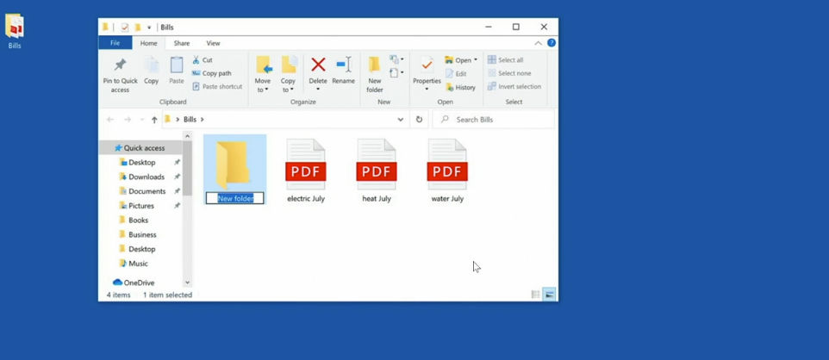

Slide 35
Understanding your Home (user) Folder

Slide 36
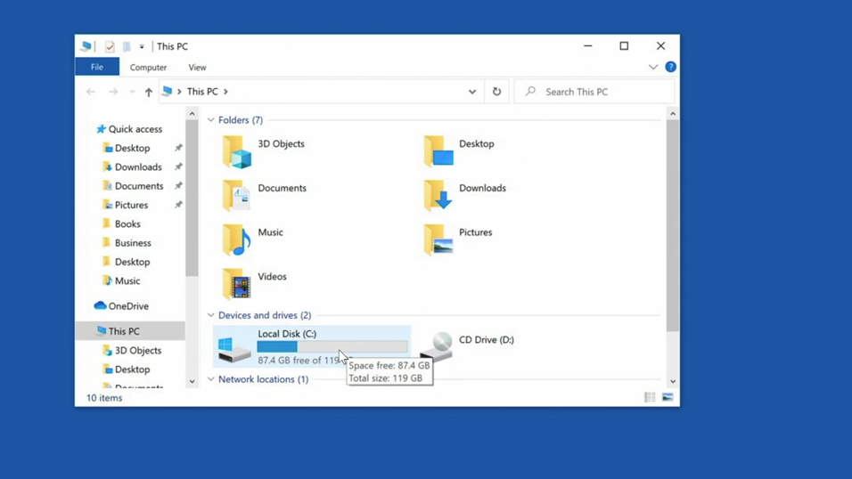

Slide 37
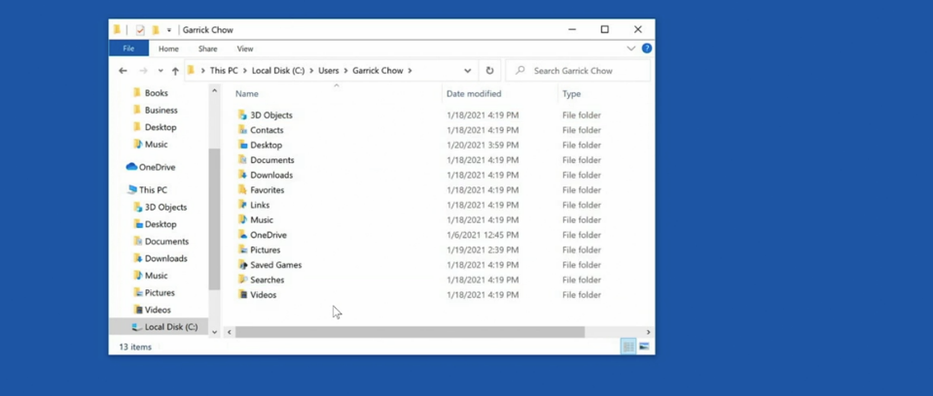

Slide 38
How to use your desktop

Slide 39


Slide 40
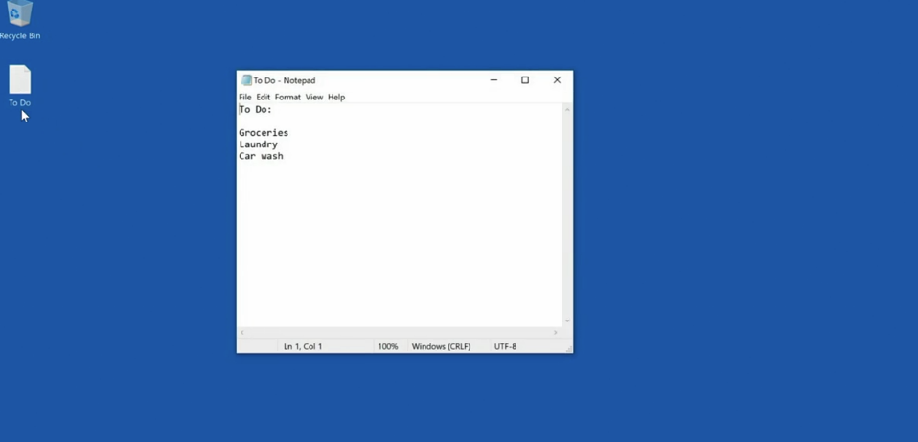

Slide 41
How to Delete a File

Slide 42


Slide 43


Slide 44
Understanding Right Click

Slide 45
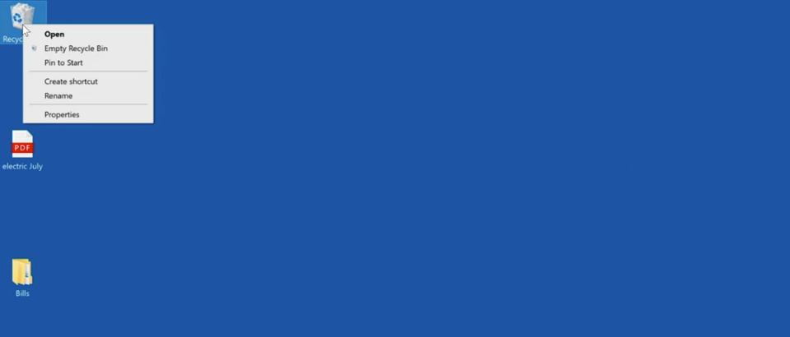

Slide 46
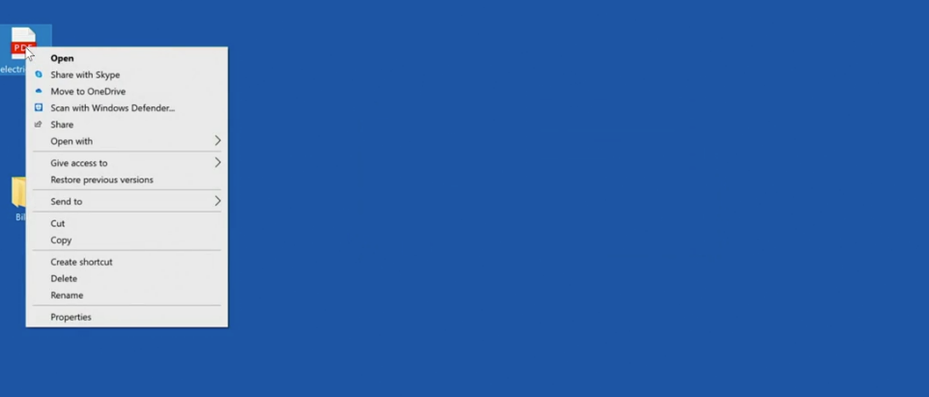

Slide 47
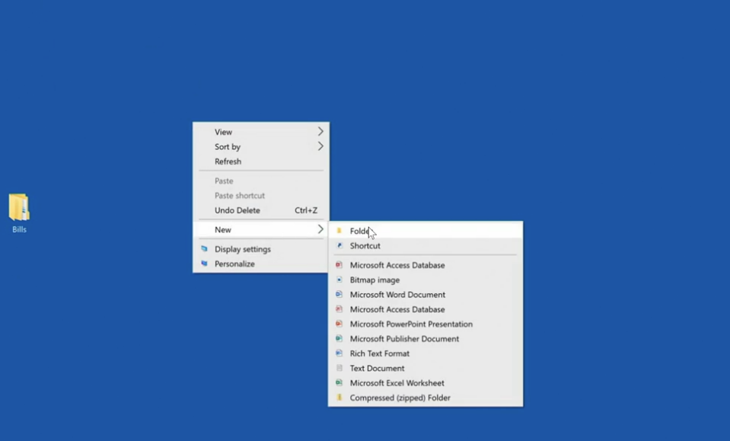

Slide 48
Software Applications

Slide 49
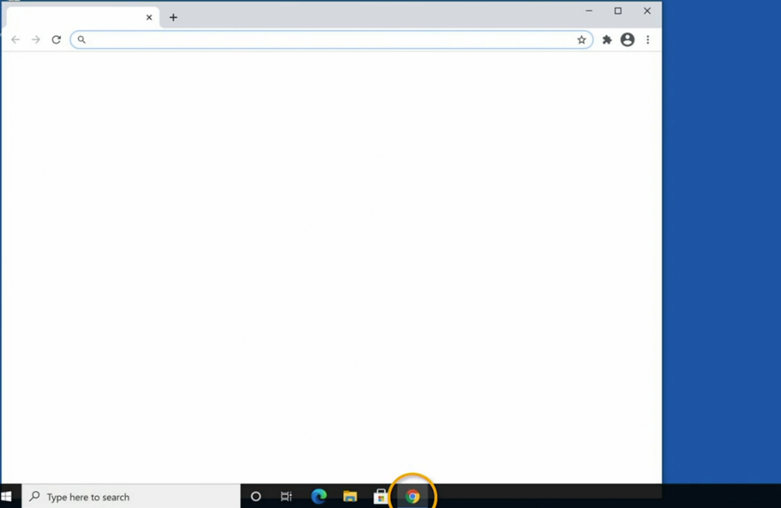

Slide 50
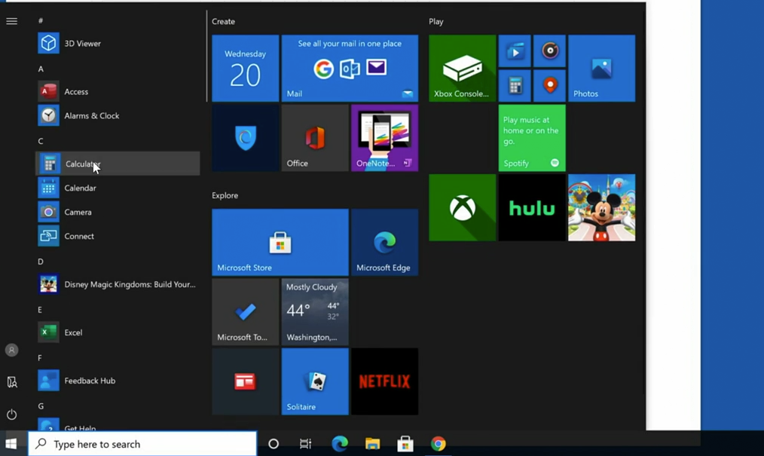

Slide 51
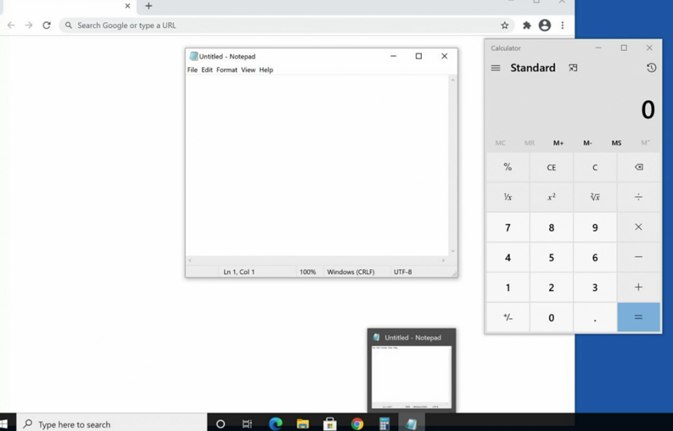

Slide 52
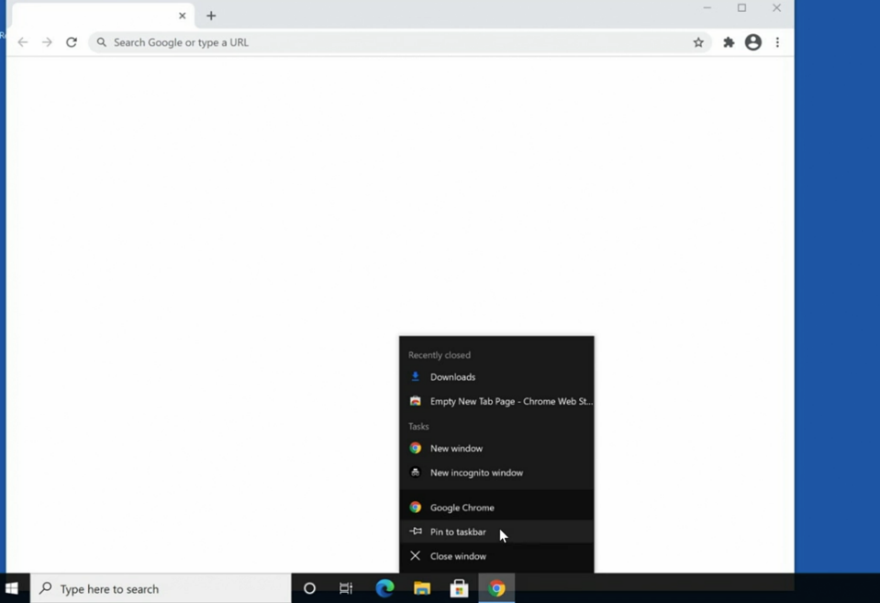

Slide 53
How to open and save files

Slide 54
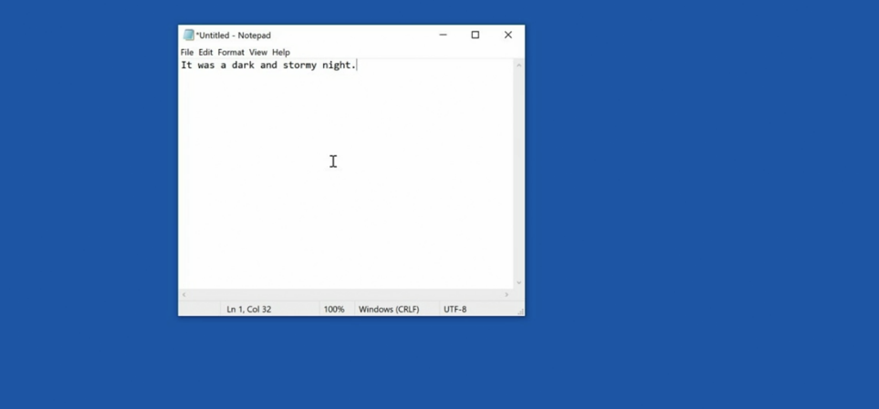

Slide 55
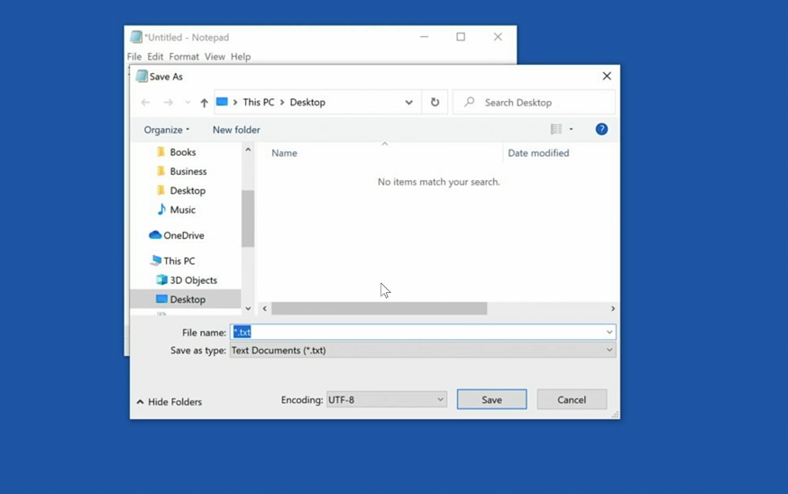

Slide 56
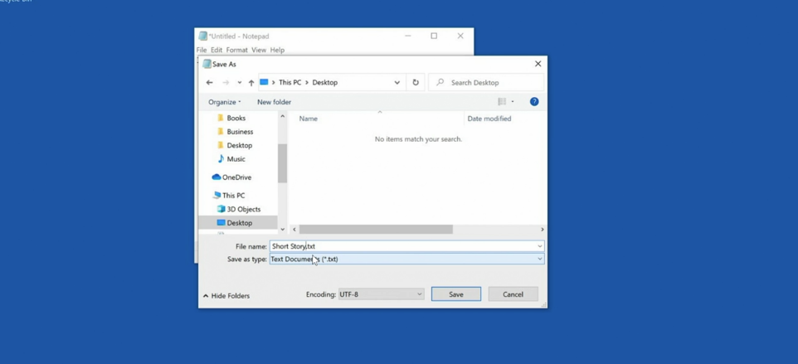

Slide 57
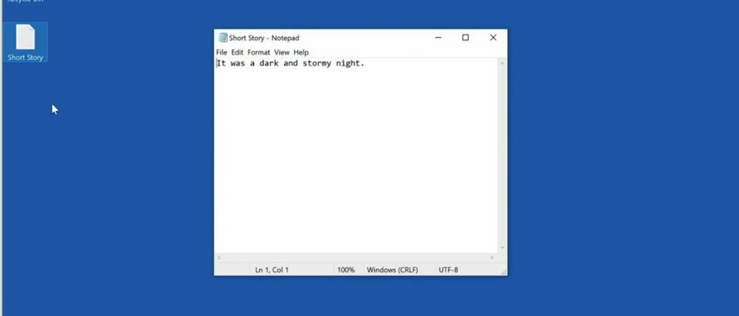

Slide 58
Five things that work in all applications

Slide 59


Slide 60
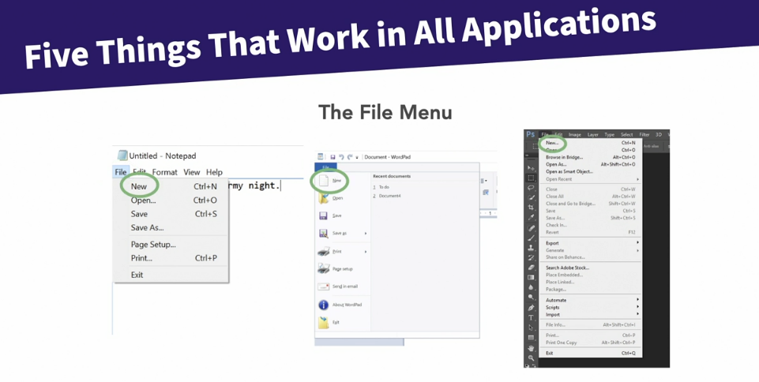

Slide 61


Slide 62
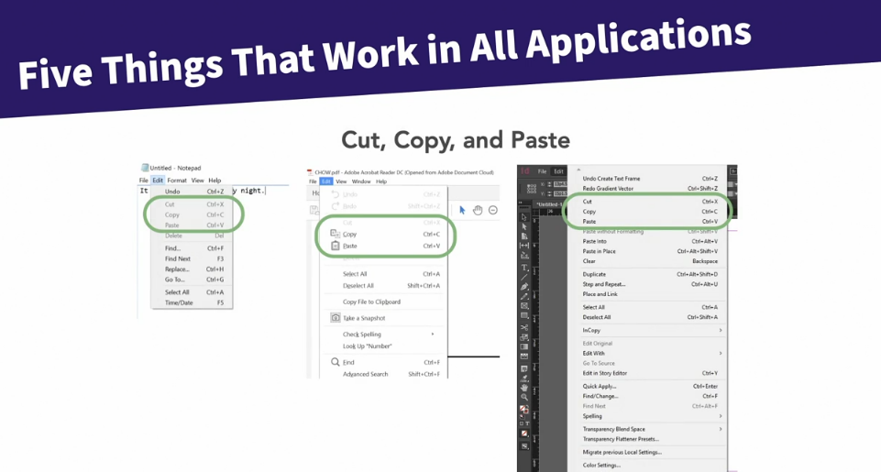

Slide 63
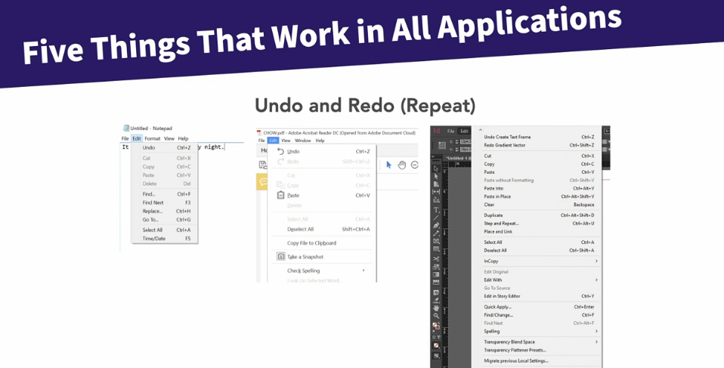

Slide 64
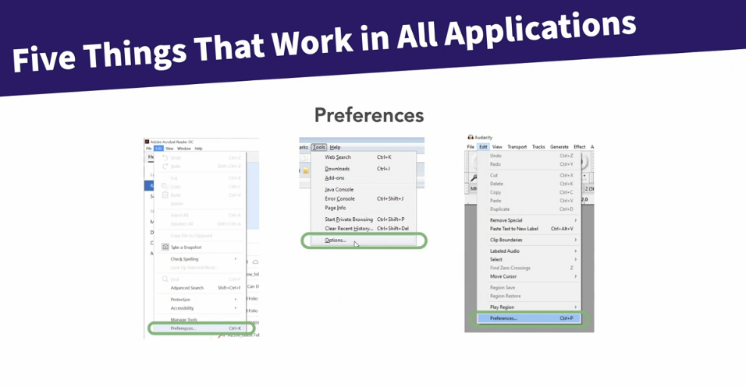

Slide 65
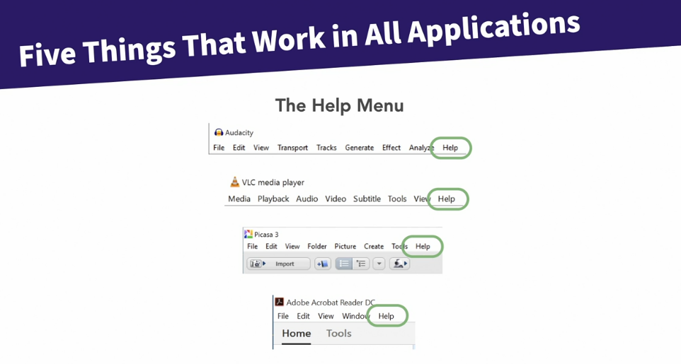

Slide 66
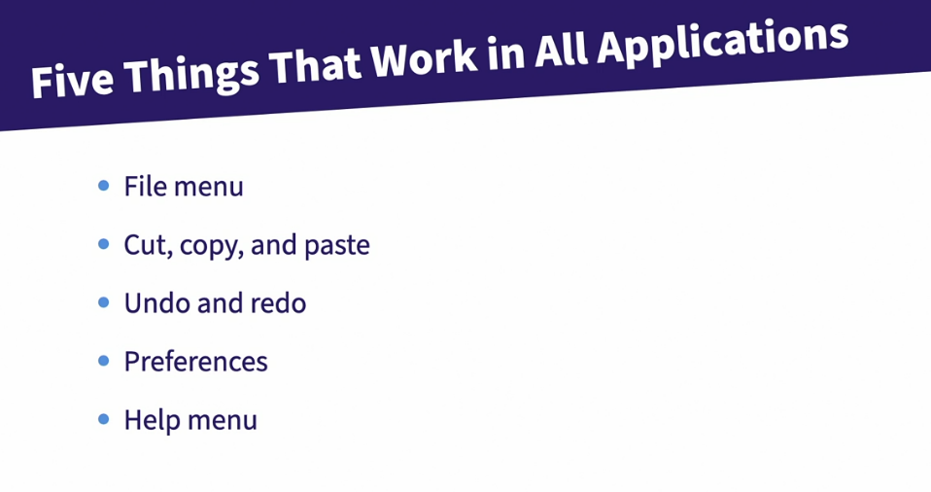

Slide 67
Computer Ports

Slide 68
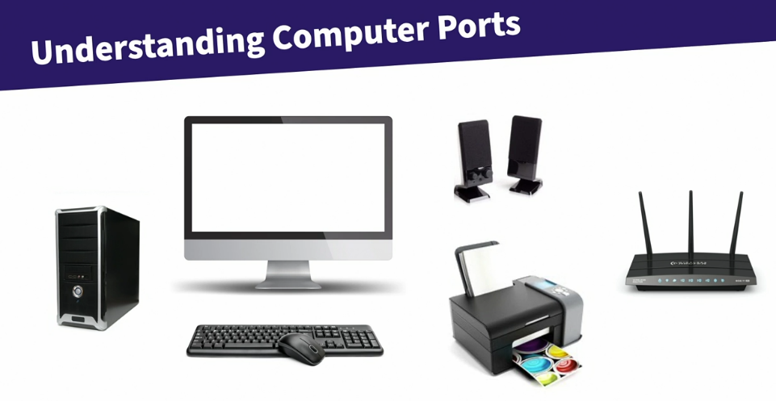

Slide 69
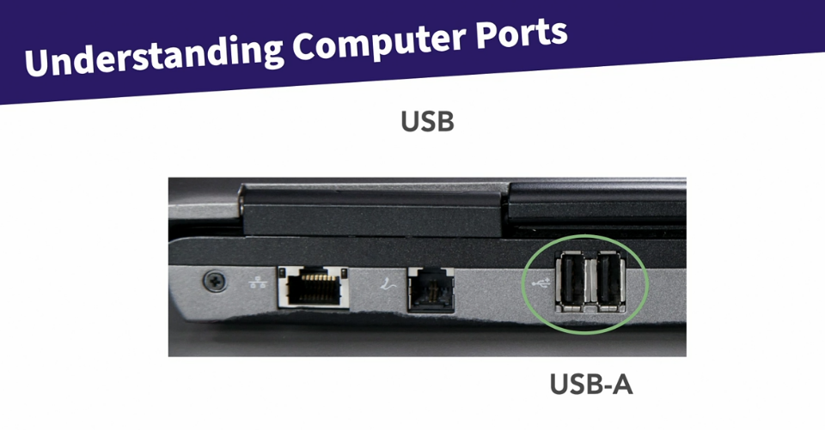

Slide 70
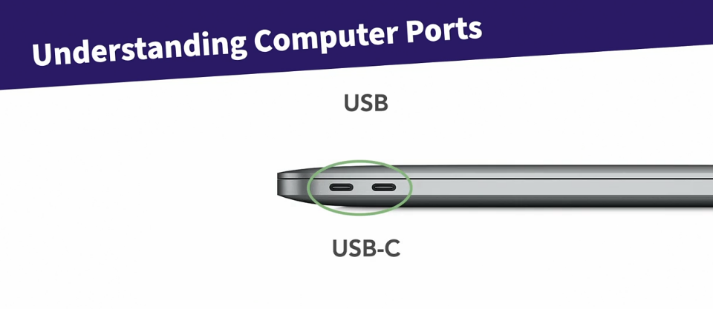

Slide 71
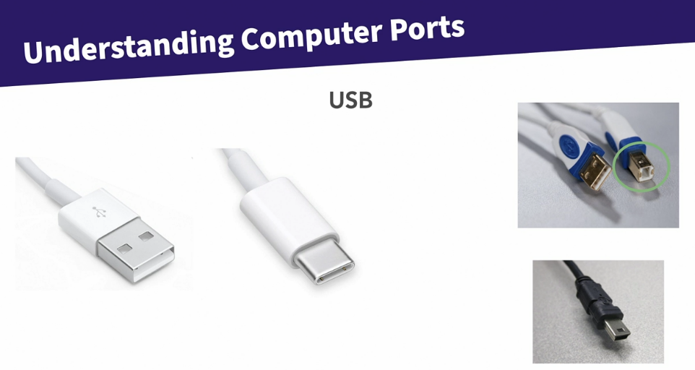

Slide 72


Slide 73


Slide 74


Slide 75




Slide 76


Slide 77


Slide 78


Slide 79


Slide 80


Slide 81
Understand networks and internet access

Slide 82


Slide 83


Slide 84


Slide 85


Slide 86


Slide 87


Slide 88


Slide 89
Understand email servers and clients

Slide 90


Slide 91


Slide 92


Slide 93


Slide 94


Slide 95


Slide 96


Slide 97


Slide 98


Slide 99


Slide 100


Slide 101
Search Engine Basics

Slide 102


Slide 103


Slide 104


